Slide 1
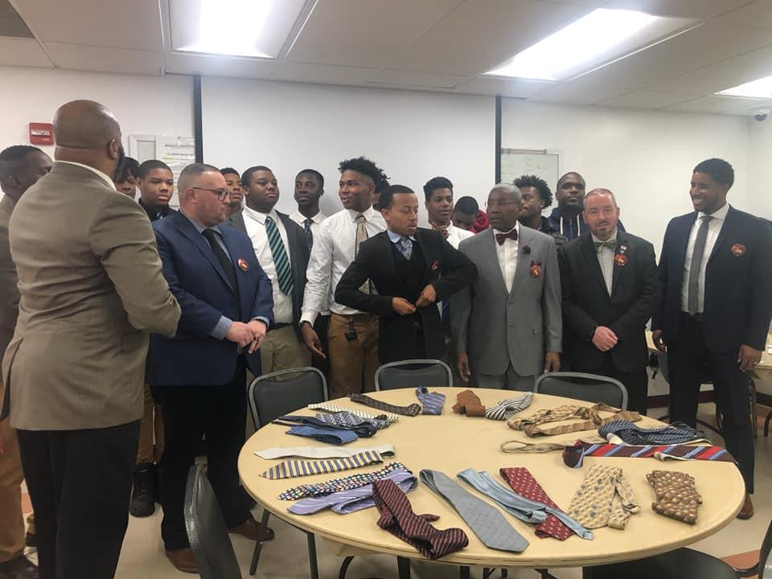
The Royalty Institute of Leadership and Innovation
5404 Old Temple Hills Rd, Temple Hills MD RoyaltyInstitute.Org

Slide 2
Mission and Vision Statement
Mission Statement - To prepare the Black leaders of tomorrow through innovative skills training and leadership development in a christian environment focused on an equitable approach to learning
Vision - To change the communities in which we partner by making an investment into the young people of tomorrow. We want an education that prepares students for the world they are walking into with a knowledge base that gives them the bast chance to be successful

Slide 3
What we offer
An Individualized Curriculum based on student motivations in new and expanding industries- Penn Foster
Leadership Institute (every student is registered)
Students will grow their mental, physical and emotional abilities through leadership seminars EVERY THURSDAY!!!
Experiential Learning-Community First Job training in a real world environment
Career and Job training for all student, making them responsible members of our society from day 1
First Class Athletics training built into the school day.
Access to ALL of our resources THROUGH COLLEGE GRADUATION
Family and Community support and resources
Community Outreach

Slide 4
ACADEMIC
STRUCTURE

Slide 5
ACADEMIC STRUCTURE
We employ an academic approach that is year round and student centered and paced. This allows students to take full ownership of their learning and creates an equitable approach to teaching students regardless of starting point.
Individualized, Computer Based -Curriculum
Certified Online Instructor and a Hybrid Certified/Assistant Instructor Personnel
Self Paced
Social Justice Education
Small group support
11 month school calendar - To aide in retention

Slide 6
Mr. Smith - Example of the prototype student
Increased GPA from 1.3 GPA to 3.3 GPA year one in The Royalty Institute
Obtained an internship with Salvation Army of America, logging over 100 hours of service in the community
Applied to Va Union University, college interest from ASA Miami

Slide 7
Our Partnership with Agape Family Faith Center
We have partnered with Agape Family Faith Center to serve in the Prince Georges county community… specifically in the Temple Hills area. Agape Family Faith Center ("AFFC") is a family place where people gather to experience the presence of God through worship, teaching, ministering, and fellowshipping. It is a place where serving others and impacting our community is a core value. We are a Christ-centered, Spirit-filled church that welcomes people of all backgrounds. At "AFFC", you can expect the worship to be heartfelt, the message to be relevant, and the atmosphere to be warm and loving. Led by pastor Arthur Clark, Agape is a vital partner to the mission at Royalty as we host class sessions and community outreach at the church site among other roles and responsibilities in advancing our community

Slide 8
LEADERSHIP AND INNOVATION SEMINAR

Slide 9
LEADERSHIP AND INNOVATION SEMINAR
This seminar is how we develop the leaders of tomorrow, and equip them with the skills to be the very best young man they can. Every Thursday we reimagine education, and provide our students with a day of learning centered around:
Leadership Development
Innovative Skill sets
Community Service
Non Traditional School Programming
Employable Skills
Experiential Learning

Slide 10
Leadership and Innovation Seminar Highlights ()offered to date
Barbering
Information Technology Institute
Small Business/Entrepreneurship
Interacting with the police - Cottage City Police Department
Leadership Seminar(s)- Speakers Include- (How to tie your tie- 100 Black Men PG County ,Nicole Tiovanni, Lody Boy - Taylor Gang, Jared Johnston- Author)
Literacy Event w/ University of MD
Read Across District Heights
Museum of African American History and Culture

Slide 11
COMMUNITY ENGAGEMENT EVENTS

Slide 12
ROYALTY FOOTBALL CAMPS
https://www.royaltyinstitute.org/royalty-football-camps
20+ Kids last session
Camps Throughout the year
Part of the players community service initiative
Fundamentals Based; no contact camp that follows the Royalty Leadership Blueprint
Portion of the camp goes to investors and building upkeep; A portion goes to myself and our football coaches

Slide 13
ROYALTY BIKE DMV
https://www.royaltyinstitute.org/royalty-bike-dmv
Biked the county with multiple sponsors to raise money for the Royalty Education Fund

Slide 14
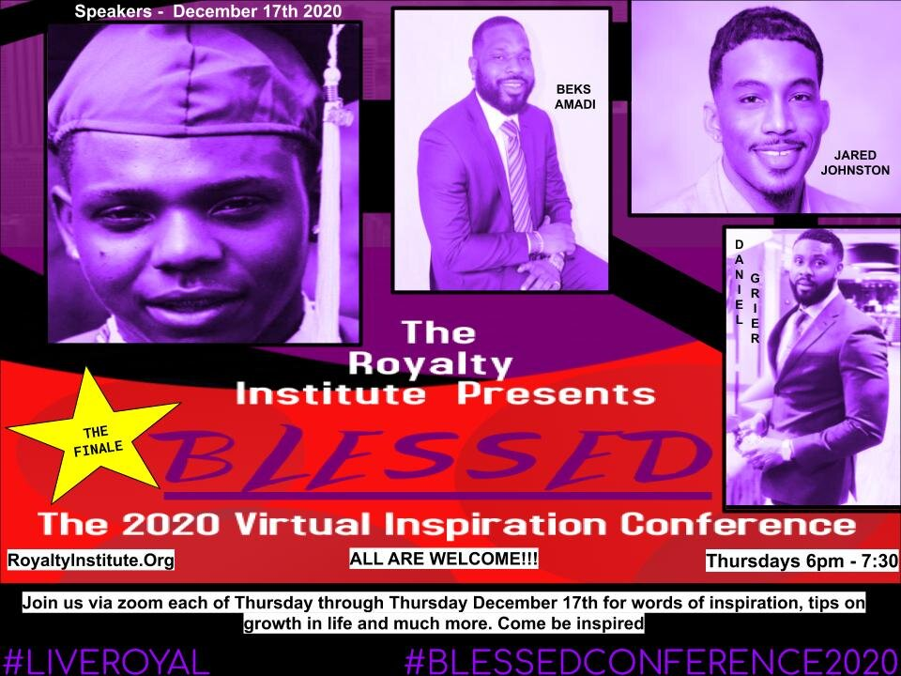
THE BLESSED VIRTUAL INSPIRATION CONFERENCE 2020
https://www.royaltyinstitute.org/blessed-conference
5 Week Conference
Speakers from Across the culture
40+ young men participated over the 5 week conference

Slide 15
Other events and fundraisers
Royalty Bike DMV
Royalty Fish Fry
Royalty Chicken and Waffles
Royalty Wristband Sales
Popcorn Sales
After School Tutoring
Paint and Sip @ Culture Coffee Too
Community Day w/ Agape and MD Bucs

Slide 16
The Royalty WishList
The Following Items are what we are still seeking assistance in acquiring for our student athletes
The Fences Project-$20,000
Financial Assistance for Operating cost We also have a $360,000 yearly operating budget
Technology Cart - Chromebooks or Used CPU’s (our instruction is 100% computer based). All students need a laptop for the school year
Weight Room Renovation- Field Turf Squat Racks
E Sports Lab Renovation
Football Equipment for 30-60 players (this includes home and away jerseys, 15 helmets and shoulder pad sets for to supplement what we already have
Bus/Van for student shuttle
Campus Revitalization- Remodel of the Classroom and Hallway- SP the plug

